Slide 1
Use of CMOS cameras
in exoplanet transit photometry
EPSC 2018 – Berlin, Germany – Gabriel Murawski (AM1)
Notes:
Good afternoon! My name is Gabriel Murawski and I’m an undergraduate student at Medical University in Bialystok, in Poland. However, I’m an astronomy amateur and my largest interest are exoplanet transits. I am not using a CCD camera that ground-based observatories are equipped with, but a modern one with CMOS sensor. In this presentation I want to show my results, thoughts, conclusions and opinions based on exoplanet transit observations in past two years. [30s]

Slide 2
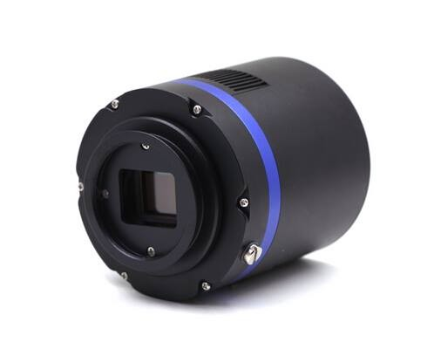
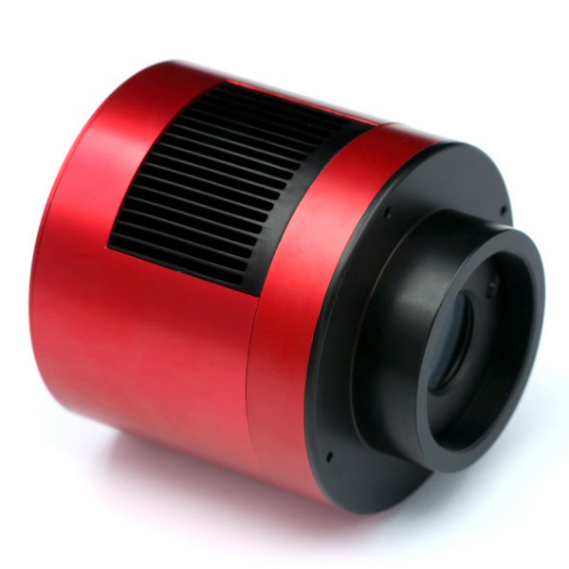
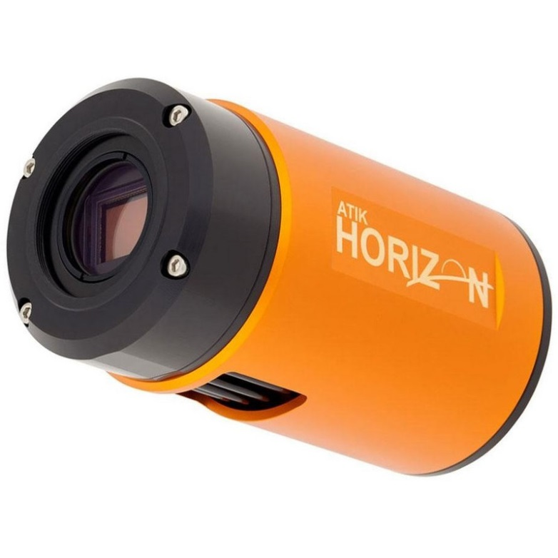
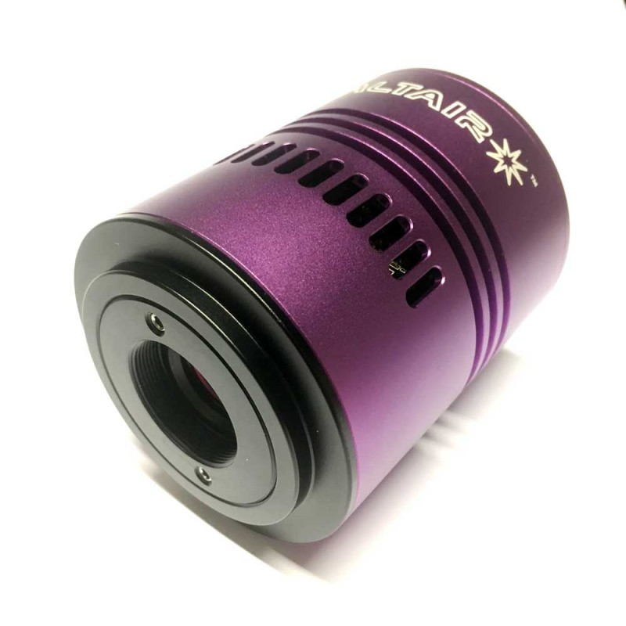
Notes:
These low noise cameras have a significant role around astrophotographers, but their performance hasn’t been given aprobate from variable star observers. There are multiple manufacturers producing cameras, but they often base on the same CMOS sensors, like IMX178. Producents known from CCD cameras are focused on CMOS too, like Atik or FLI. Compared to CCD, these have lower prices and are more accessible to amateurs. [25s]

Slide 3
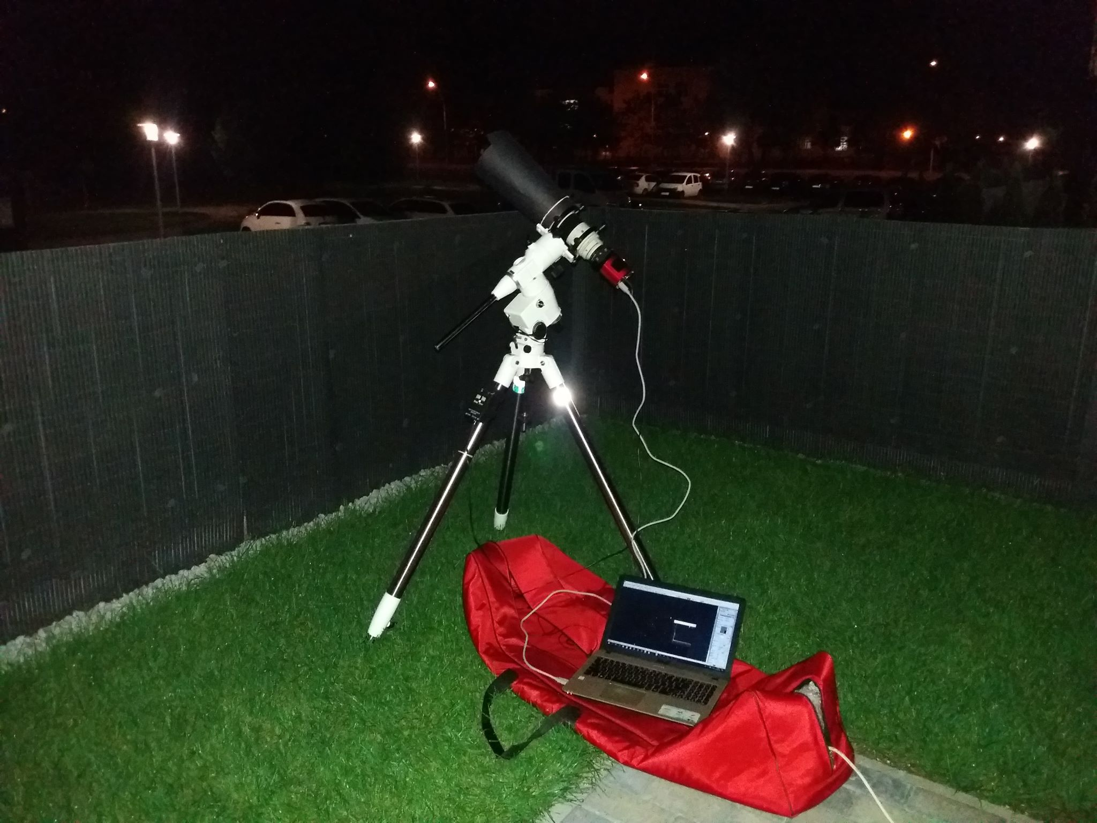
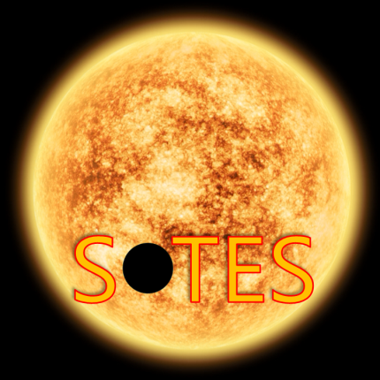
Canon FD 300mm f/2.8 L lens
EQ5 mount
ASI178MM-c camera
Pixel size: 2.4µm
Scale:
1.65”/px (300mm)
0.65”/px (800mm)
ASUS laptop
Notes:
In observing, I use 6.2-megapixel ASI178MM-c camera. It is attached to Canon lens with 4 inch aperture. I also began testing with a Newtonian 8-inch telescope with f/4 ratio. Beside that, I also use Baader BVRI photometric filters and a clear blue-blocking one. To obtain images, I use SharpCap software. For reduction and stacking – Muniwin, for photometry – AstroImageJ and Excel. [25s]

Slide 4
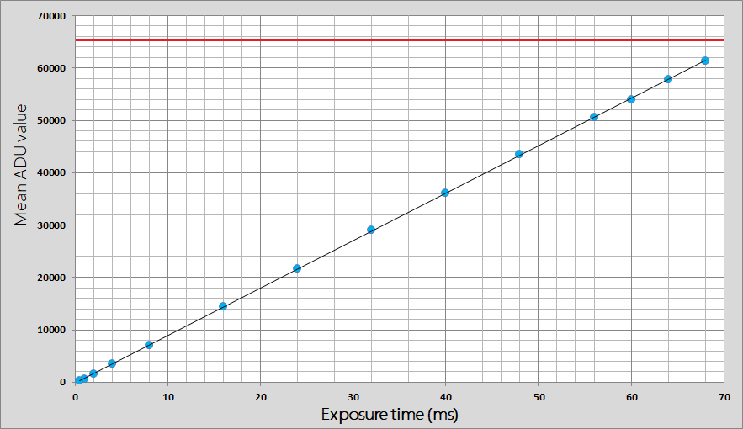
IMX178 looks linear up to maximum ADU value. Similar results are observed in other CMOS cameras.
Linearity test
Notes:
Before starting photometry, one of the most important things is to perform a linearity test. I obtained a few flat frames and calculated mean ADU levels on each image with AstroImageJ software. It revealed that CMOS cameras are linear up to saturation limit when using default gamma and brightness value. [20s]

Slide 5
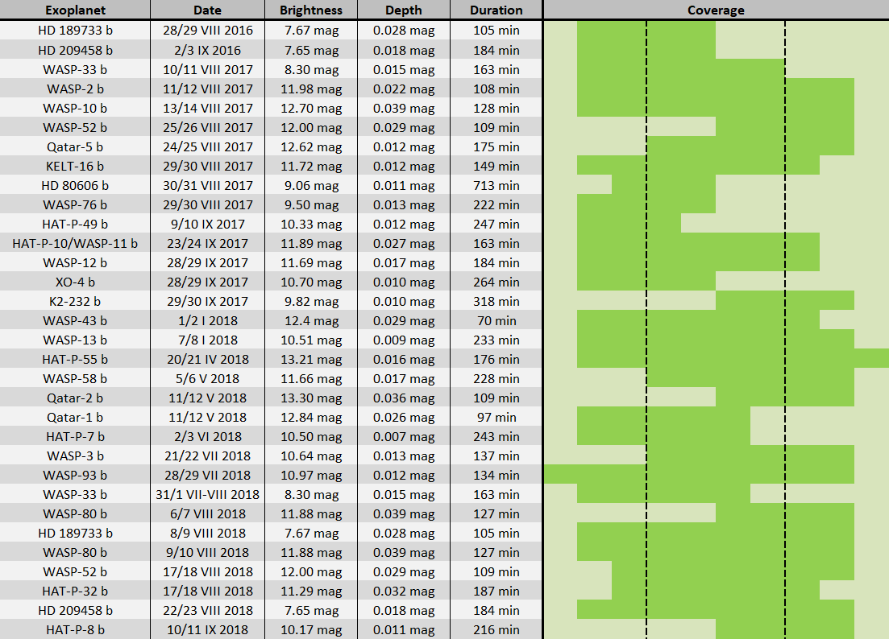
Notes:
This table is an overview of all successfully observed exoplanet transits so far with equipment presented before. In almost all attempts, a clear blue-blocking filter was used. Photometric filters are used only for candidates found by KELT and Kepler, also soon for TESS. [20s]

Slide 6
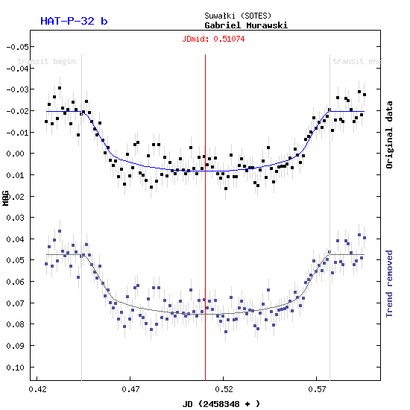
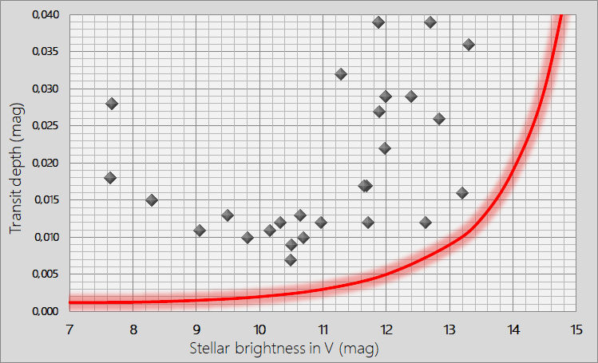
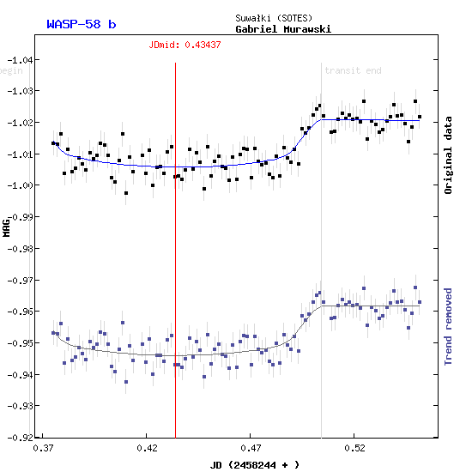
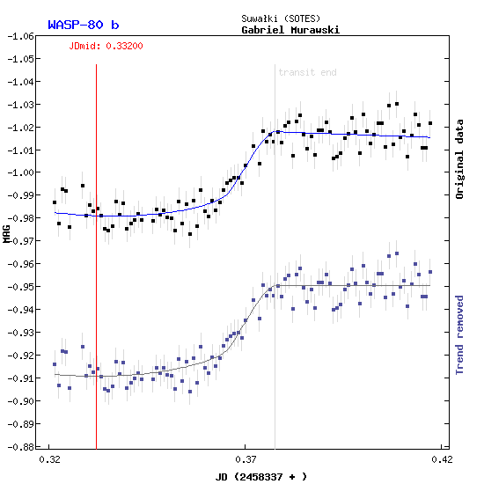
Transit depth limits for 4-inch lens and CBB filter in typical conditions.
Properties of transits
Source: ETD
Notes:
Photometric precision is the key. Depending on stellar magnitude, I obtain frames with exposure between 1 and 20 seconds with CBB filter. Then, I stack into 2-minute frames. Presented line shows approximate minimum depth that would be still detectable. Of course there are many variables, like Moon phase, elevation, transit shape and duration or access to referrence stars, but accuracy prediction is consistent to every new observation.
Marked points show positively observed transits. Faint targets are usually not observed, because of mount and light pollution limits and small 4 inch aperture. Exoplanet candidates and low amplitude variable stars were not included. This camera has a good near infrared transmission. It works best with V and R photometric filters, where scatter is only 20-30% higher than with a CBB one. For 8-inch telescope, line must be shifted to the right by one magnitude. [60s]

Slide 7
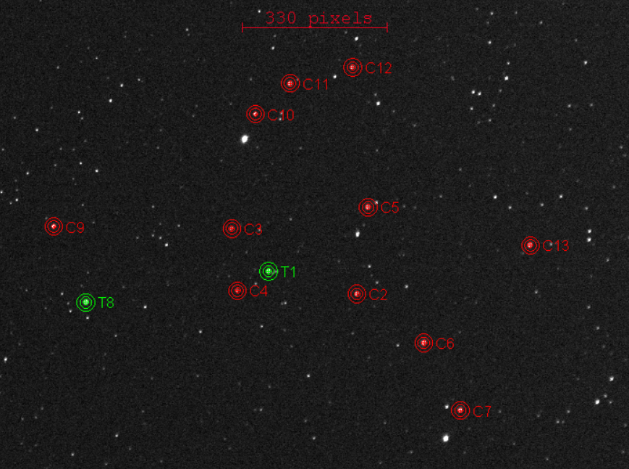
WASP-3 b
Star: 10.64 mag
Depth: 0.013 mag
Duration: 158 min
Constellation: Lyra
Purpose of short exposures
Notes:
Cameras based on CMOS allows to record with a high frame rate. A typical CCD often requires seconds to save a frame, while CMOS does that almost instantly. One of observed exoplanets is WASP-3 b, marked as T1. A single exposure time there is four seconds. Short exposures have very high scatter, so measurements have to be binned... But how? [25s]

Slide 8
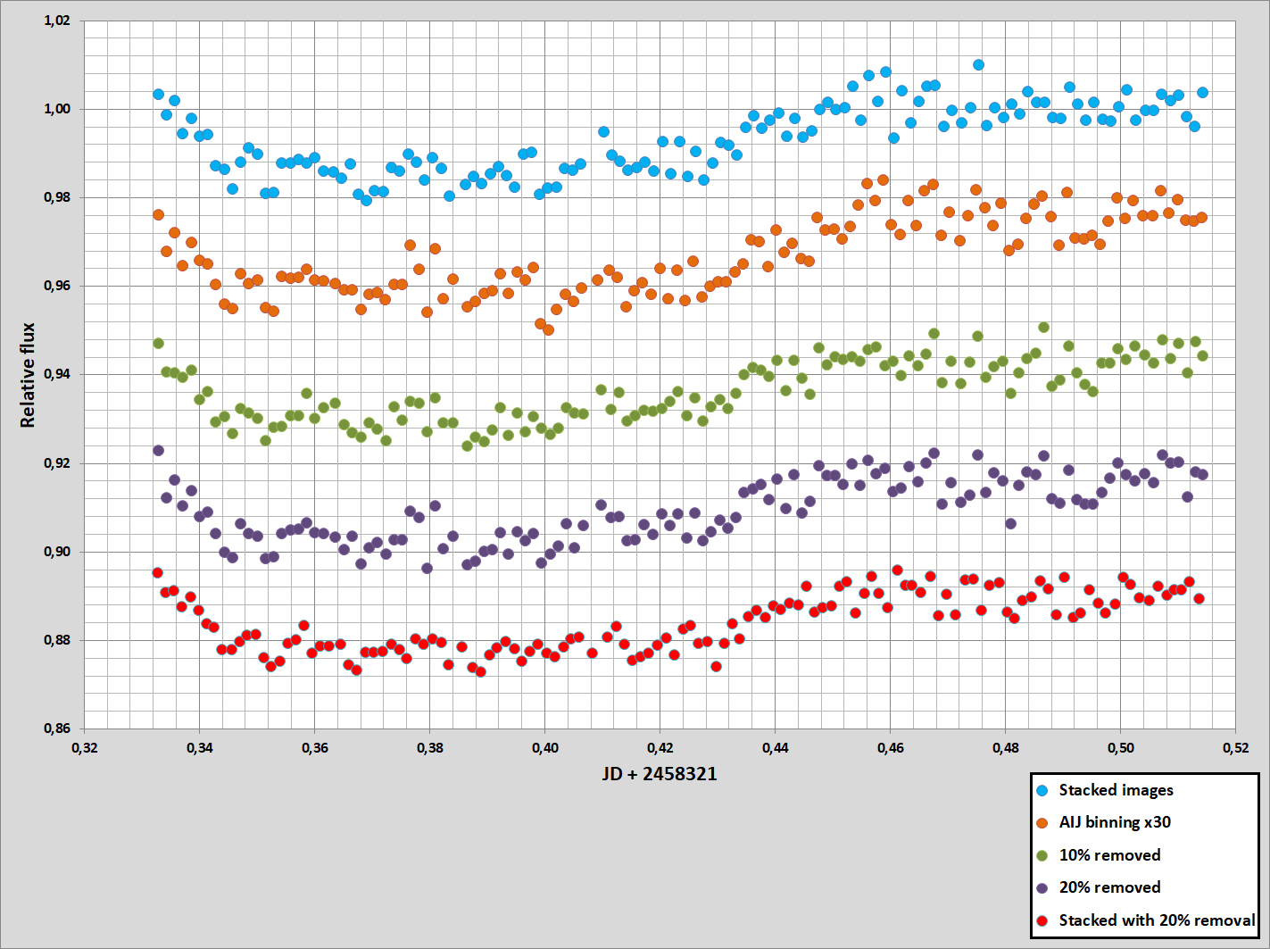
standard error value
2.8 mmag
3.2 mmag
2.5 mmag
2.8 mmag
2.0 mmag
Usage of short exposures
Notes:
The first graph comes from stacked frames into 2-minute integration time. I publish results to Exoplanet Transit Database this way. The second one is an average of 30 datapoints, also giving 2 minutes in total. The scatter is higher. Third and fourth curve shows accuracy from averaging frames, but after removing measurements that are away the most from zero point by using percentiles. The last one is a combination – I stacked only these frames that were not included in violet graph. No averaging, just stacking selected frames and doing photometry on them.
This concludes that stacking improves the accuracy than averaging single ones. Removal of a few worst datapoints helps too, but note that 10% removal has lower standard error than 20%. Combining two methods give the best precision. It is worth investigating other ways to improve the accuracy, for example by checking quality of stars. This is not possible on CCD frames, because we work only on long exposures, where selection is not available. [70s]

Slide 9
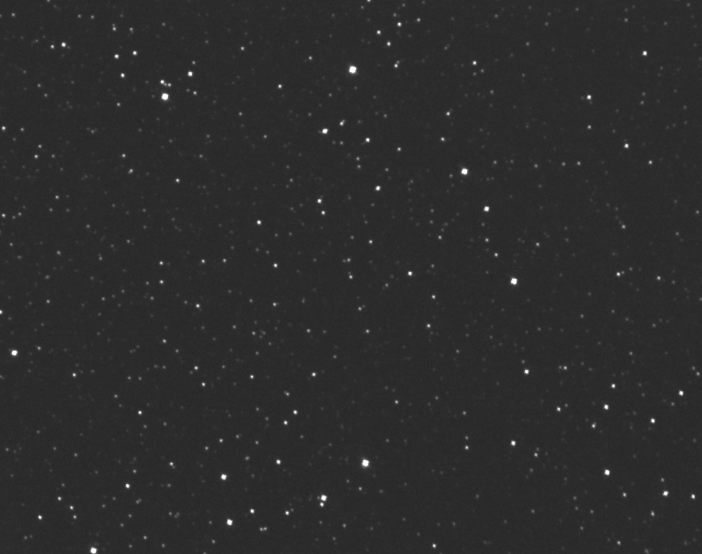
TESS SOTES (300mm)
Resized to the same scale
Resolution
Frames obtained with Newtonian 8” f/4 telescope have even better resolution!
Notes:
CMOS cameras have very small pixels, so blended stars can be separated easily. Even with so short focal length it’s possible to resolve most of near eclipsing binaries when observing KELT or TESS exoplanet candidates. Single exposures don’t have a large dynamic range, but stacking improves it. As an example, on WASP-3 b observation presented before, it’s possible to find them around stars down to 6 magnitudes fainter. This makes a small and cheap setup a powerful tool in verification of candidates. Despite extremely small sensor, observations resulted in discovery of more than 50 variable stars. Except that, a Warm Jupiter K2-232 b detection was presented in discovery paper leaded by Yu et al. [50s]

Slide 10
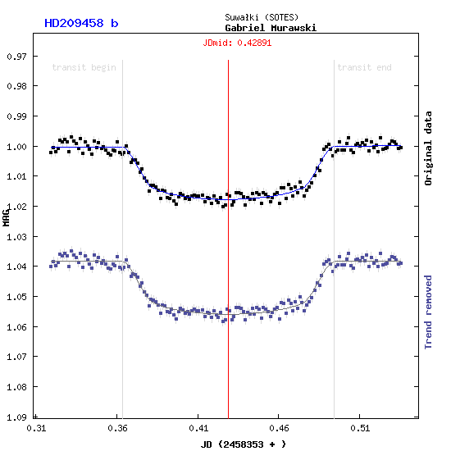
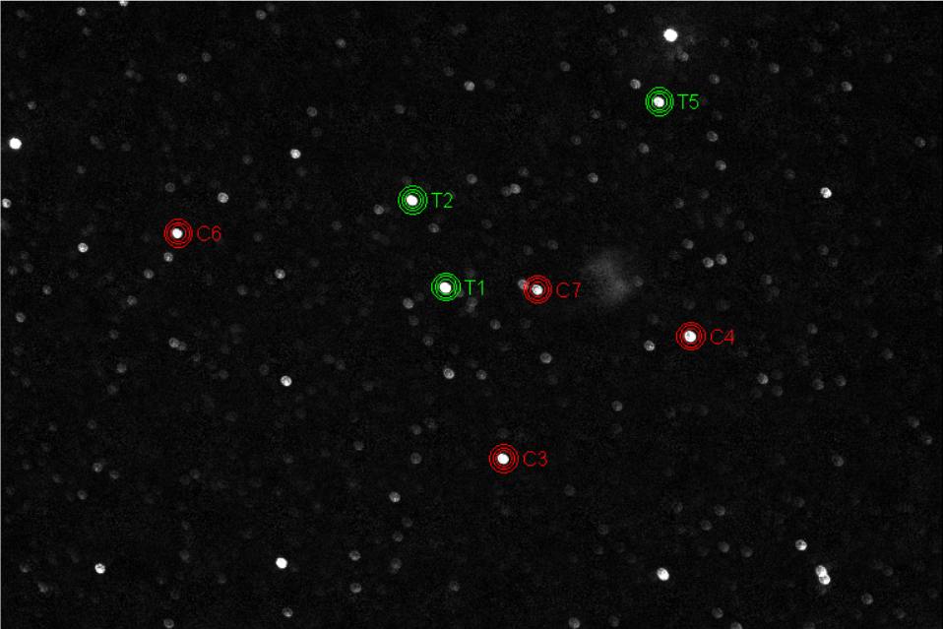
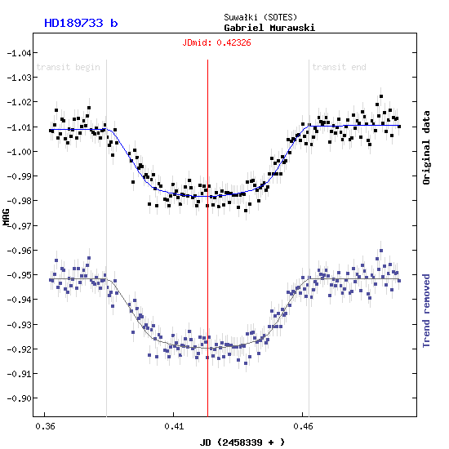
HD 209458 b
HD 189733 b
With 8-inch telescope
With 4-inch lens
Defocused stars
Notes:
One of methods used in photometry is to defocus, especially when the target is very bright. I made two attempts on two targets with almost the same magnitude, but the lower one is deeper and much shorter. The biggest problem that was NOT clearly seen on focused images is trend, even if a good precision was achieved. Exposures are much longer, so our photometry process is quicker, unless we need to spend some time on detrending. By using a CMOS camera, I noticed that accuracy is quite similar to attempts with short exposures, when several frames are stacked to a single datapoint. This confirms that read noise doesn’t have a large impact on precision and we’re almost limited only to scintillation, if only the star is exposed enough. We can reduce this effect with methods mentioned before. Also, if I defocus, I can’t check fainter stars for near eclipsing binaries. This is not a good approach when observing exoplanet candidates. [75s]

Slide 11
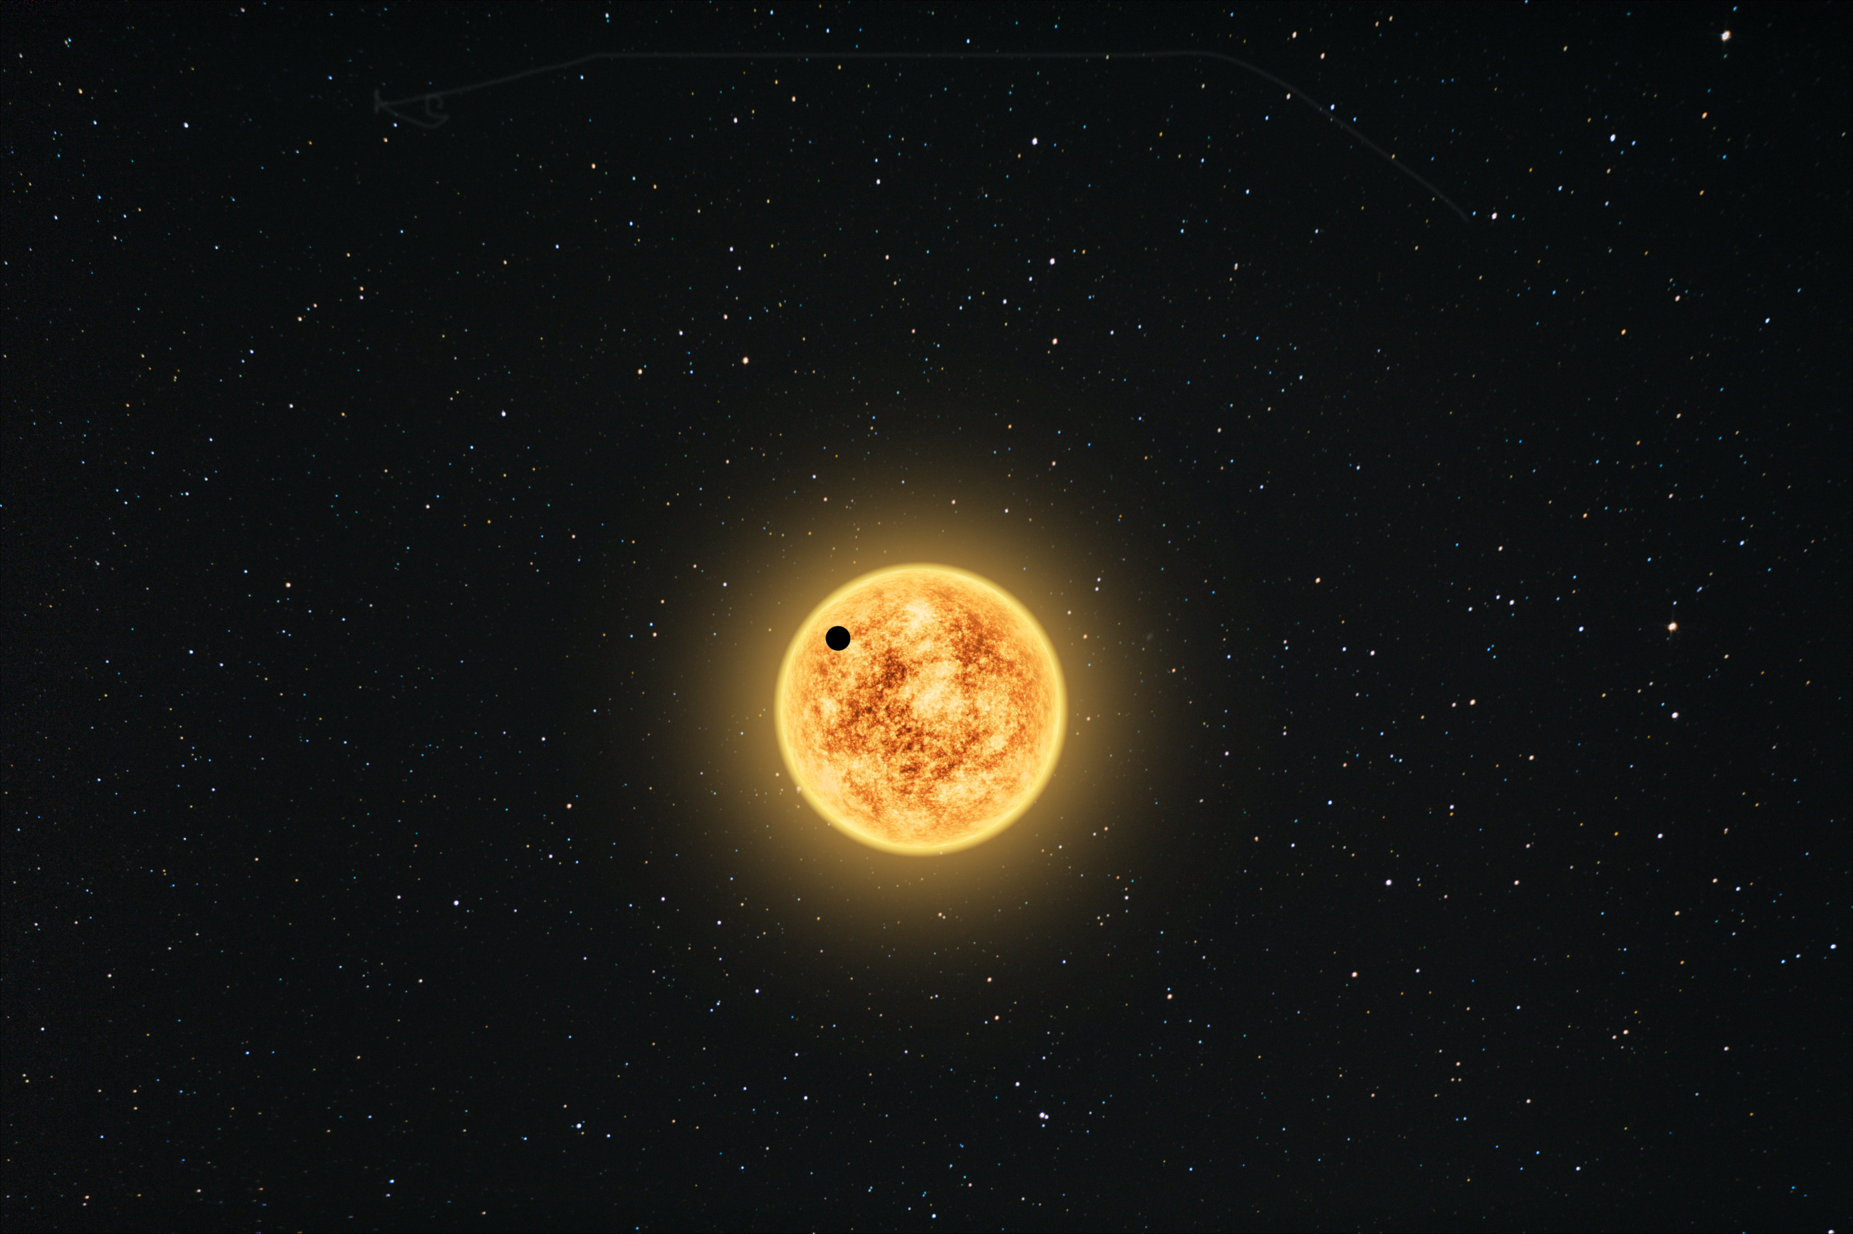
Conclusions
Notes:
CMOS cameras work very well with small telescopes. If we plan to use a telescope with aperture more than 40 centimeters, large pixel size becomes necessary. Also a little sensor gives small field of view. There are currently no such monochrome cameras available, but they are still under development. From ZWO’s offer, there are two models worth checking – 178 and 1600. The second one has larger sensor, a bit larger pixels, but is still small compared to those in CCDs. But these are 14-bit and 12-bit, respectively. This makes a very low dynamic range, so 16-bit CCDs work better for surveys. But that doesn’t make a large problem in high precision photometry if we obtain short exposure frames. Scintillation makes scatter so large that 12-bit frame have enough precision. We need to stack many frames for a better range, so we generate a lot of gigabytes. However, accuracy is still comparable to CCD results published in ETD. But it’s worth mentioning I’m doing this with much cheaper setup, which is more accessible to amateurs.
I want to continue this subject with CMOS cameras, by moving to 8-inch Newtonian telescope and ASI1600 camera. Larger aperture and sensor allows to observe fainter targets with a better precision. This project is a preparation of TESS follow-up observations, after first release of possible candidates in northern hemisphere. [85s]

Slide 12
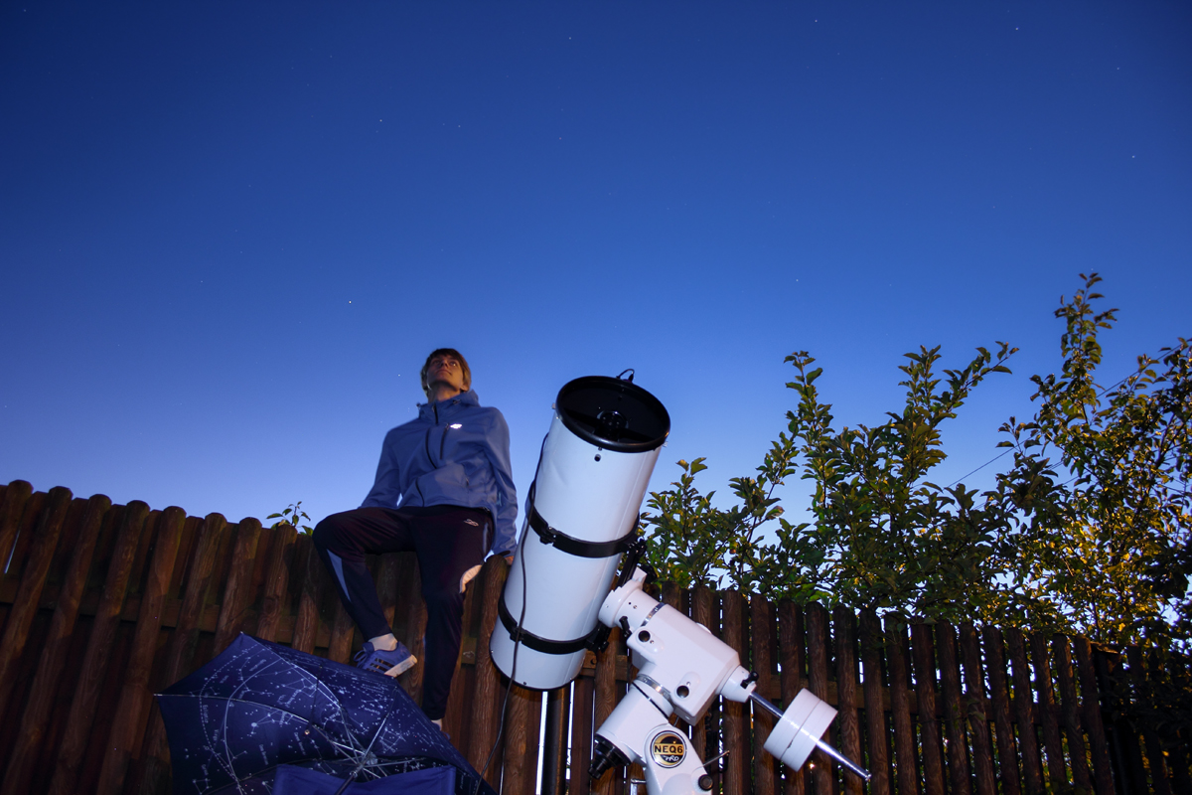
Thank you for your attention! Questions?
I want to thank Tomasz Ściężor and Joshua Pepper for making comments!
Notes:
Thank you all for your attention! Are there any questions? [5s]

